Slide 1

Reception Admissions
For September 2026 intake

Slide 2
Key Dates
Your child's birthday should fall between 1st September 2021 and 31st August 2022
The application process opened on 1st September 2025
The deadline for online applications is 23:59 on 15th January 2026
An offer email will be sent to the email address used to complete your application during the evening of the 16th April 2026.
Log into your eAdmissions account by 30th April 2026 to tell us if you accept the offer from us or not.

Slide 3
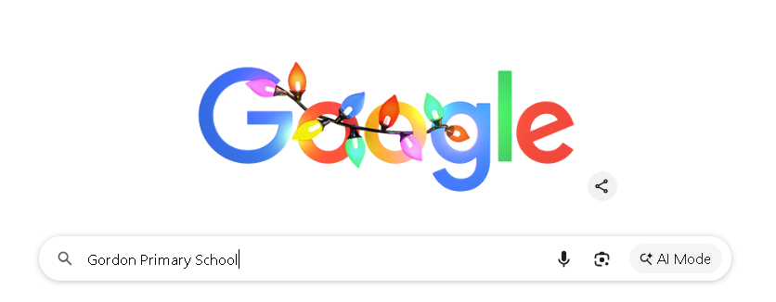
1. Search for the school website.

Slide 4

2. Make sure you select the one with ‘gordonpri’ in the title.

Slide 5
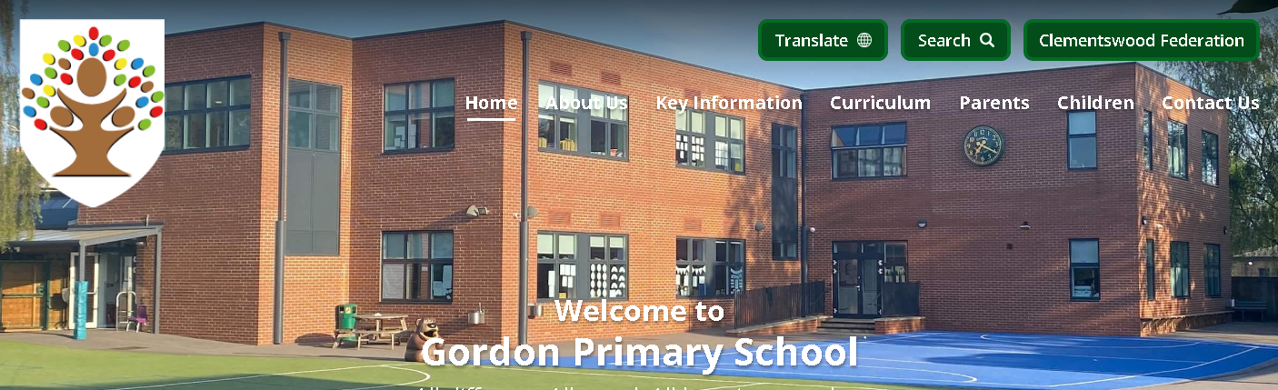
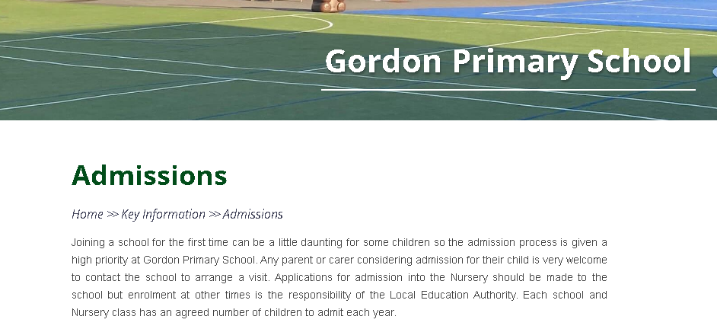
3. Click on ‘Key Information’.
4. Select ‘Admissions’.

Slide 6
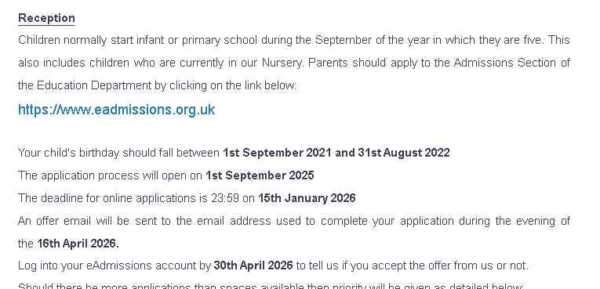
5. Scroll down to the ‘Reception’ section and click on the blue link.

Slide 7
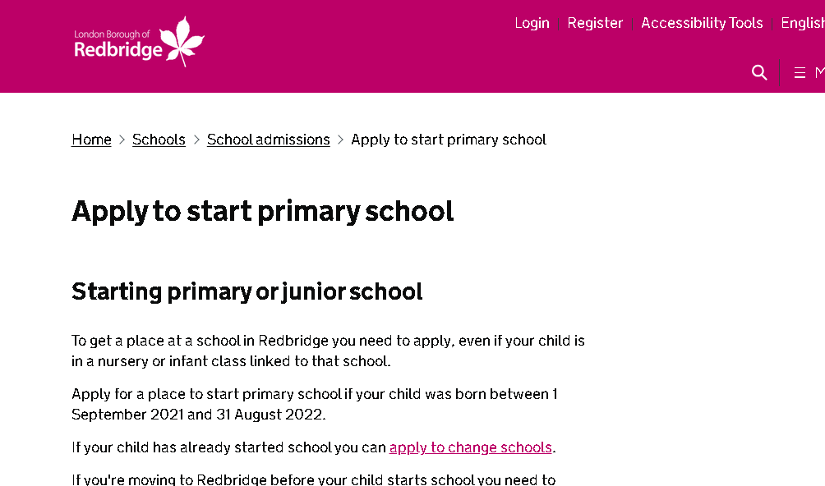
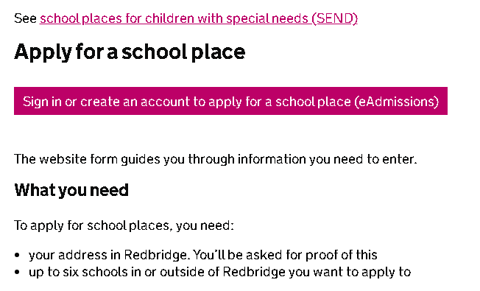
6. Scroll down and click on the pink bar.

Slide 8
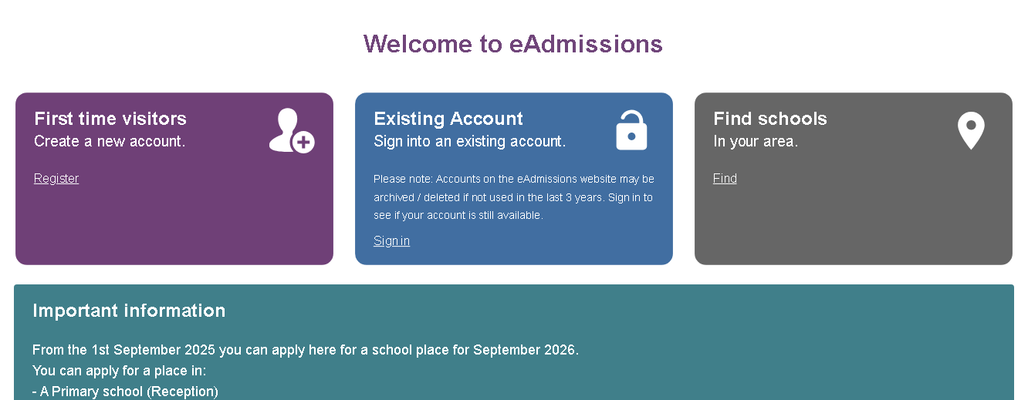
7. You will need a list of 6 schools that you want to apply for.
- Use this function to find local schools in Redbridge.

Slide 9
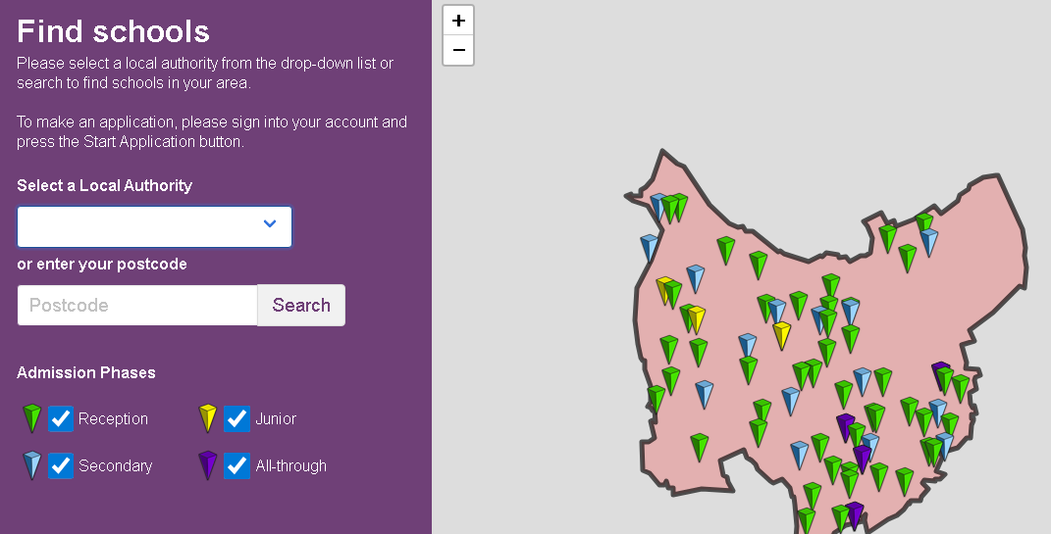
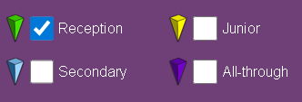
8. Uncheck the boxes for ‘Junior, Secondary and All-through’ to find schools that you could apply to, for your child.

Slide 10
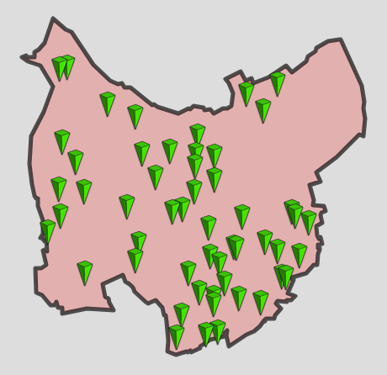
10. Hover over the green pins to find the name of the schools.
- We are located in this part of the borough.

Slide 11
9. Select the correct option and register or sign in.
- You may need to reset your password if you have an existing account but have forgotten your password.

Slide 12
The next page is your home page called 'My school admissions.
If you can see your child's name on your 'My school admissions' page, select the 'Start new application' button below the child's name.
This button will only be available for children whose date of birth falls within a relevant age range.
Check existing details and select the ‘Next' button.
If your child’s name is not listed, select the ‘Start a new application for a child that is not listed below' button.
Enter the details requested about the child you are making the application for on the 'Child details' page and select the ‘Next' button.

Slide 13
Please remember Council tax account number: Some local authorities will ask you to provide this information for the address where your child lives.
For more details select ‘Local Authority details’ button on the left hand side bar to see your council’s policy on this. ]
Child’s current school: Please select the school from the drop down list. Only type the name of the school in the box if your child is at a nursery school or you cannot see the current school name listed.
Twins or triplets: If you have twins or triplets you must make an application for each child and tick the multiple birth box.

Slide 14
Add your preferences in the order you prefer them.
You can select up to six schools.
Make sure you include the details of any brothers or sisters who will be attending one of the schools or linked schools you have applied for. If you do not tell us you may lose out on a place allocated under the sibling criterion.
Please be aware that not all schools have a medical or social criterion, please check before selecting your schools.
If the schools you have selected allow medical or social criteria and you would like your child to be considered under this criterion you must tick the relevant box and attach supporting evidence. You can attach documents once you have submitted your application. If you do not provide the evidence to support your application, your request cannot be considered under that criterion.

Slide 15
Some schools ask you to fill in extra forms called supplementary information forms (SIF).
If you do not fill in these forms and/or send them direct to the relevant school, you risk your chance of getting a place at these schools.
It is your responsibility to check that your online application is fully completed and that you have entered all details correctly.
If you do not tick certain boxes or enter relevant information (for example sibling box) your application will not be considered under that criterion.
Each time you fill in the information on a page, make sure that you select ‘Next’ button or the information will not be registered.

